Slide 1
TELEPHONE DIRECTORY
Om Arora RA2211003010120
Rahul Mathur RA2211003010116
Aditya Mathur RA2211003010096

Slide 2
agenda
Problem Statement​
Concept Used
Demo Output
Conclusion

Slide 3
Problem Statement
In the contemporary era of rapidly evolving telecommunications services, the imperative of efficient contact information management has never been more pronounced. Across various industries, particularly those with a dispersed workforce operating from different geographical locations, the telephone stands as the primary and often sole means of communication. In such diverse and dynamic settings, a seamless and user-friendly method for storing and swiftly retrieving contact details becomes an absolute necessity.

Slide 4
Concepts Used
1. Class "Contact":
Custom Data Structure: The `Contact` class represents a custom data structure that encapsulates information about a contact, consisting of a name, a phone number, and a reference to the next contact. It is essentially a linked list node as it contains a reference to the next `Contact`.

Slide 5
2. Linked List:
`Contact` Instances as Linked List Nodes: The `Contact` instances form a linked list where each contact (node) is connected to the next one through the `next` reference. This linked list data structure allows the code to organize and manage a list of contacts efficiently, with each contact having a name, phone number, and a reference to the next contact.
3. GUI Components:
JFrameThe main application window is represented by the `JFrame`, a Swing component that provides the GUI framework.
JTextField: `nameField` and `phoneField` are used to input contact information (name and phone number).
JButton: Various buttons (`addButton`, `searchButton`, `deleteButton`, `displayButton`) are used for user interaction.
JTextArea: The `outputArea` is used for displaying output messages and contact information.

Slide 6
4. Data Storage and Retrieval:
- Contact List (Linked List): The list of contacts is maintained using a custom linked list data structure, where each `Contact` node is linked to the next one using the `next` reference.
- File I/O: The code uses file input/output (I/O) to save and load contact data. It reads and writes contact information to/from external files, allowing for data persistence.
5. Event Handling:
- Action Listeners: Action listeners are used to respond to user interactions with the GUI components. For instance, when the "Add Contact" button is clicked, an action listener is triggered to add a new contact.

Slide 7
6. Error Handling:
- Try-Catch Blocks: Try-catch blocks are used to handle exceptions, such as file-related errors when saving or loading contacts. This ensures that the program can gracefully handle unexpected issues.
7. User Interface Customization:
- Customization of GUI Components: Various methods (`customizeButton`, `customizeTextArea`, `customizeMenuItem`) are used to customize the appearance and behavior of GUI components, such as buttons, text areas, and menu items.
8. Main Method:
- Swing Thread: The `main` method utilizes SwingUtilities to execute the GUI-related code on the Swing event dispatch thread, ensuring proper synchronization of GUI operations.

Slide 8
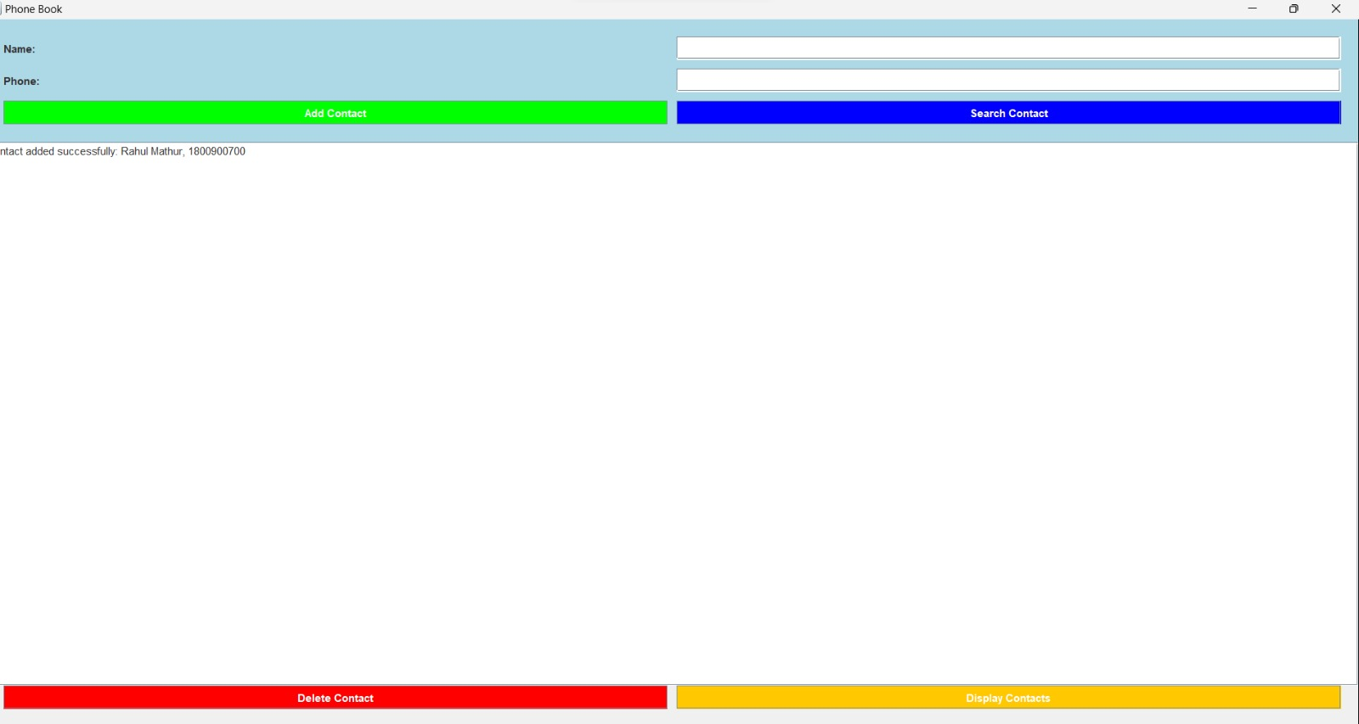
Demo Output

Slide 9
Conclusion
In essence, the code elegantly combines a set of essential programming elements to craft a straightforward yet effective phone book application. Key among these is the strategic use of data structures, with linked lists serving as the backbone for managing contact information. This linked list structure allows for the efficient organization and retrieval of contact data, streamlining the process of adding, searching, and deleting entries.

Slide 10
Thank you

